Slide 1
MIDAS
Manuel Toledo : UML Engineer, Database Specialist
Gabriel Alfonso : Quality Analyst
Edward Gil : Business Analyst

Slide 2
Problem Definition (1 slide)
Many niche apps used to track user finances
Users likely have multiple bank accounts open
Tedious to track finances through multiple applications, so why not have an all-in-one finance app?

Slide 3
Project Personnel Organization
Manuel Toledo:
Minute Taker, UML Engineer, Database Specialist
Edward Gil:
Time Keeper, Business Analyst
Gabriel Alfonso:
Team Leader, Quality Analyst

Slide 4
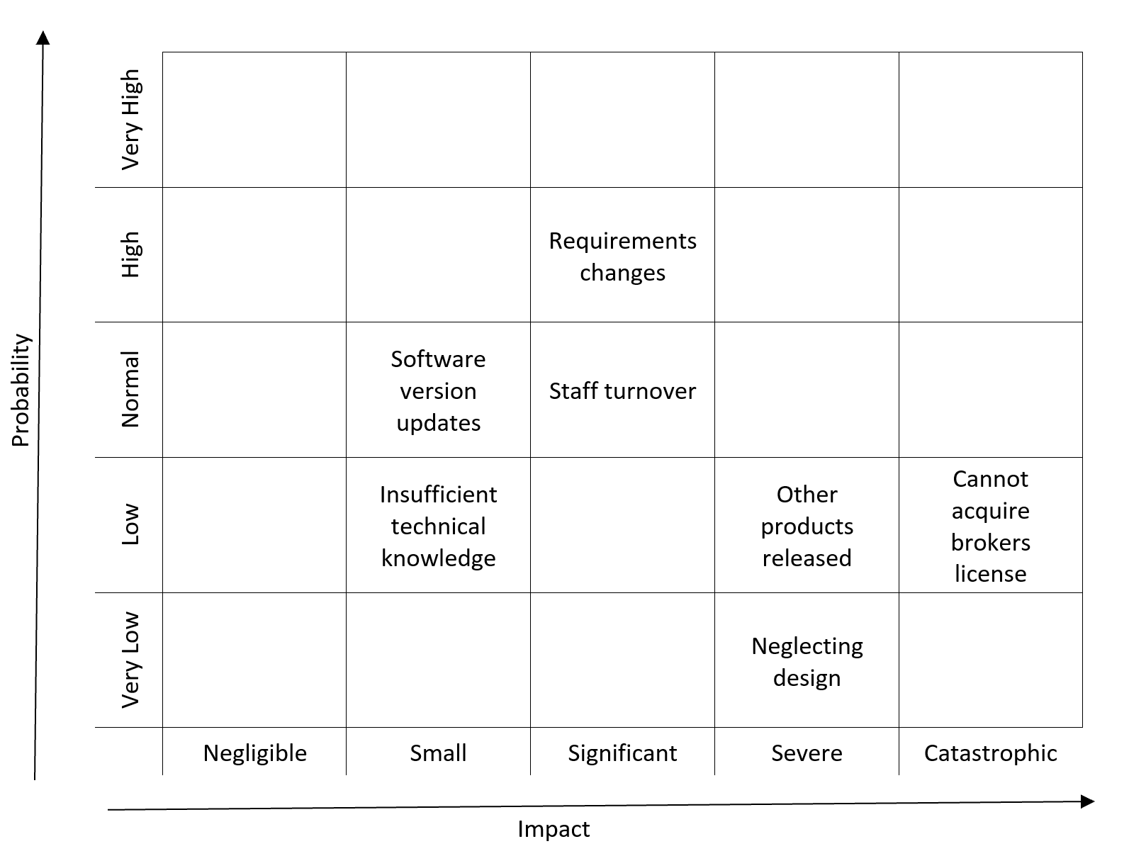
Risk Matrix

Slide 5
Risk Management Plan
Who is responsible for raising a warning?
Quality Analyst, Business Analyst, or developers
Who is to be warned?
The team leader
Who is responsible for approving the activation of the contingency plan?
The project manager
Formal steps:
If a risk may be playing out, immediately alert the team leader
The team leader brings up a list of possible ways to handle the risk
The team leader hands over the possible contingency plans to the project manager.
The project manager will then approve one of the contingency plans

Slide 6
MIDAS-7-Web-Timeout
Pre-Condition:
The user has an account and is logged in.
Trigger:
The user has been inactive for 10 minutes.
Related Use Cases:
MIDAS-14-Web-Login
MIDAS-15-Web-Logout.
Decision Support:
Frequency: For 10,000 users, timeout is expected to occur 1500 times per hour.
Criticality: Medium Criticality. Even though this use case does provide some security for the user, it is not utterly necessary for the functionality of the app.
Risk: Low Risk. This use case is simple to implement, just forcefully log out the user after some time of inactivity.

Slide 7
MIDAS-7-Web-Timeout
Constraints:
Usability: The countdown dialog box should be simple and straightforward, so the user knows what to do.
Reliability: This use case is allowed to fail 1 in 7500 times.
Performance: The user should be logged out within 2 seconds of the countdown running off.
Supportability: Timeout will be supported in Mozilla Firefox and Chrome. The mobile application will be supported in Android and IOS.
Implementation: Implemented using React and will be available on browsers and in the mobile application.

Slide 8
MIDAS-4-Web-Add Stock
Pre-Condition:
User is logged in.
User is in the Dashboard.
Trigger: User clicks on the Add Stock Button
MIDAS displays the Add Stock Page.
User inputs the stock name and the amount.
User clicks the Submit button
MIDAS will store the newly made stock entity.
Related Use Cases:
MIDAS-3-Web-View User Stocks
Decision Support:
Frequency: Medium - performed every time a user decides to add a new stock.
Criticality: High - a fundamental part of MIDAS.
Risk: Medium - requires managing data.

Slide 9
MIDAS-4-Web-Add Stock
Constraints:
Usability: No previous training should be needed, process should take no more than 20 seconds to be completed.
Reliability: Mean Time to Failure - 3 failures for every 48 hours of operation is acceptable
Performance:
Stock data should be added to the database within a second.
Add Stock page should be displayed within a second
Supportability: should be displayed properly in Mozilla Firefox and Google Chrome.
Implementation: Use case will be implemented using React.

Slide 10
Monitoring Schedule Integrity
Milestone Activities | Expected Completion | Actual Completion | Delta
Project Definition | 1/16/20 | 1/16/20 | 0
Feasibility Study | 2/4/20 | 2/5/20 | +1
Deliverable 1 Finish | 2/28/20 | 2/28/20 | 0
System Design | 4/6/20 | 4/7/20 | +1
Deliverable 2 Finish | 4/16/20 | 4/21/20 | +5

Slide 11
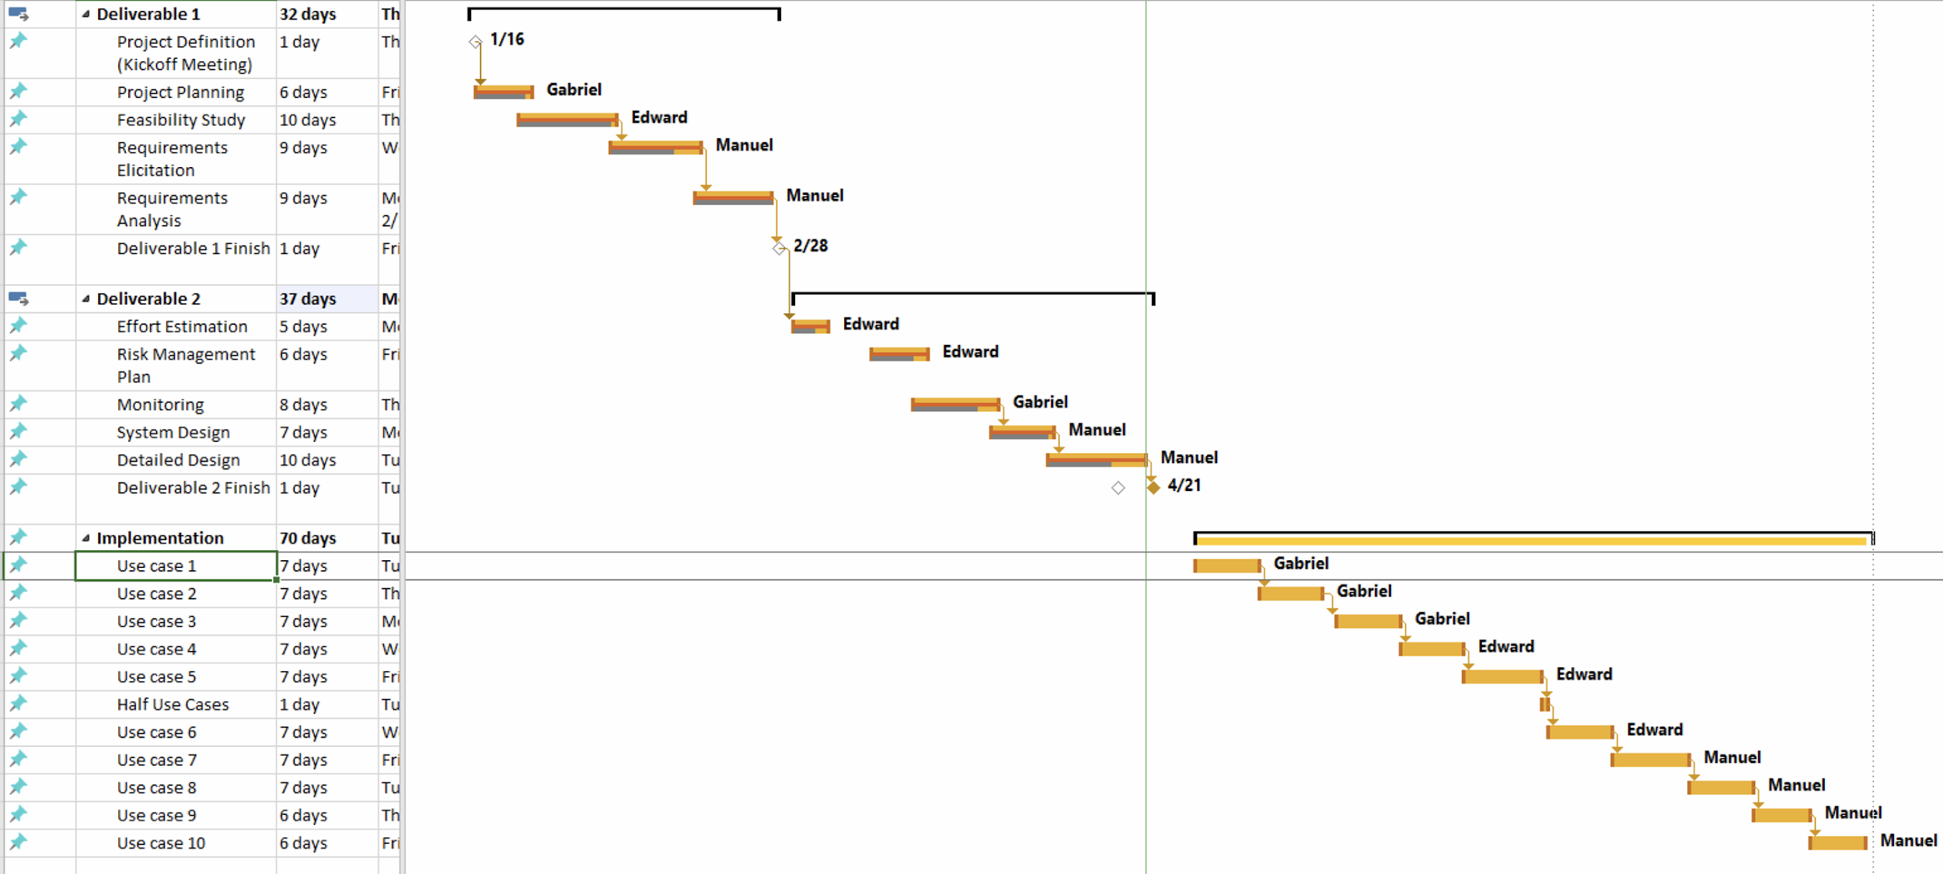
Project Plan

Slide 12
Monitoring Completeness of function
Activities | MIDAS-7-Web-Timeout | MIDAS-4-Web-Add Stock | Total
Requirements Defined | Yes | Yes | 2
Function Designed | Yes | Yes | 2
Code Implemented | No | No | 0
Function Tested | No | No | 0
Function Integrated | No | No | 0

Slide 13
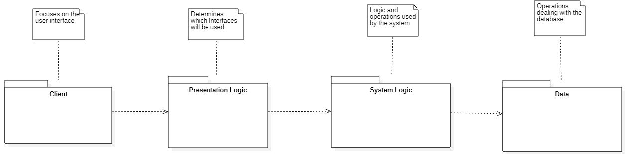
Architecture of the System: 4-Tier

Slide 14
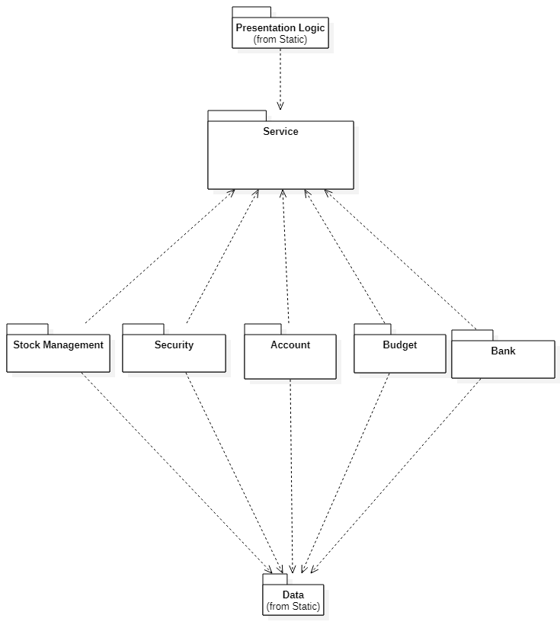
Architecture of the System: Microservices Pattern in System Logic layer

Slide 15
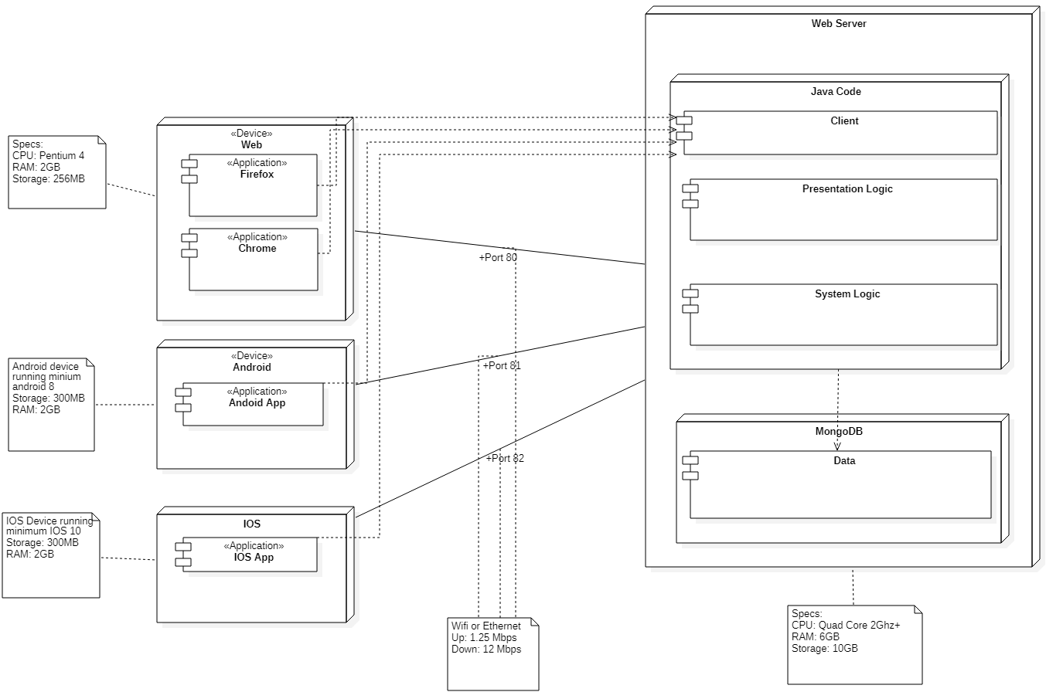
Hardware and Software Mapping: ER Diagram

Slide 16
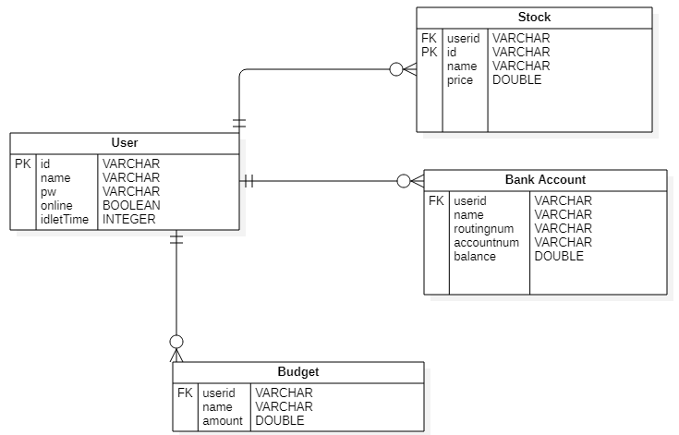
Persistent Data Management

Slide 17
Security Management
System Timeout:
used to automatically logout a user who has been idle for 5 minutes.
Password Obfuscation:
used to mask the user’s password when they are in the process of logging into the system.
Password Encryption:
will be using SHA hashing to protect the user’s password from being visible to both an intruder and the system.
works by hashing the user’s password in account creation, then when the user logs in the inputted password will be hashed and compared to the stored hash password.

Slide 18
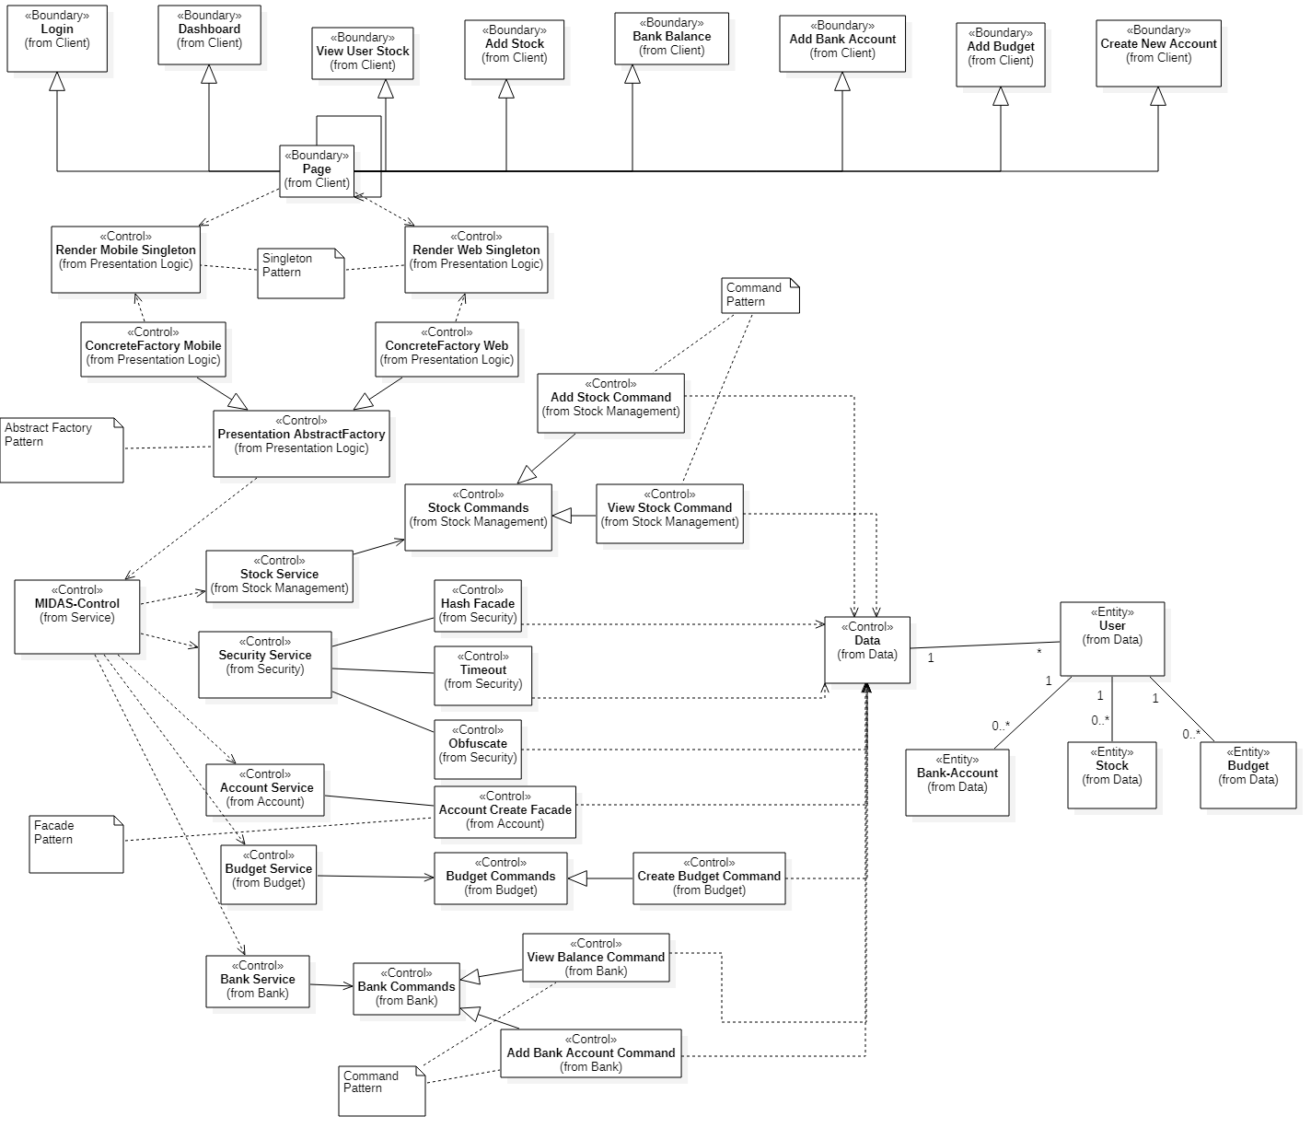
Minimal Class Diagram

Slide 19
Design Patterns
Facade pattern used for:
account creation
Command pattern used for:
budget manipulation
bank account manipulation
stock manipulation
Abstract Factory pattern used for:
rendering the different pages to the mobile apps or web browser
Singleton pattern used for:
making sure only one instance of the web or mobile pages are running for the user

Slide 20
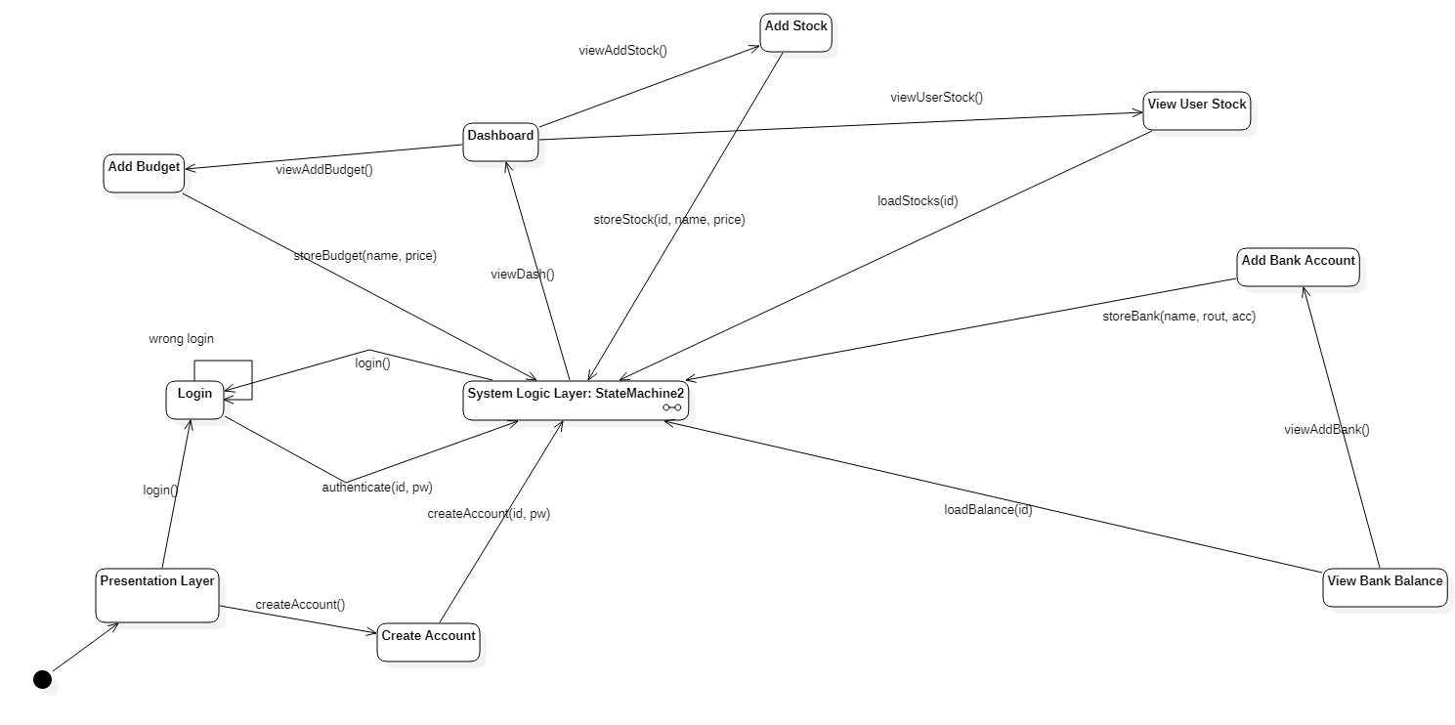
Top Level State Machine

Slide 21
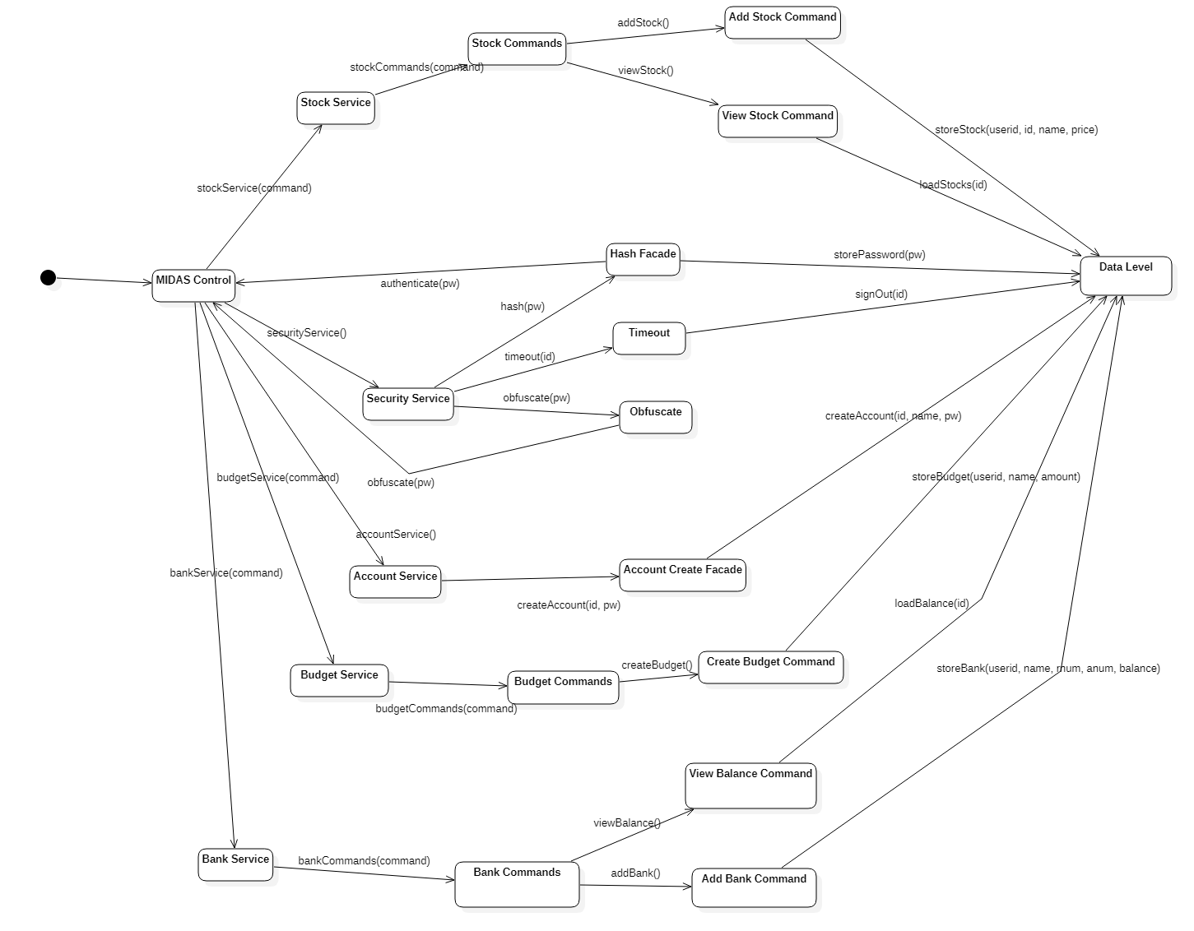
System Logic State Machine

